Slide 1
Sons of God:
Ruling and Reigning with Him
Psalm 8
08/07/18

Slide 2
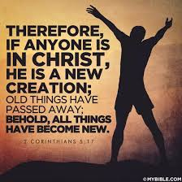
Being born again is only the beginning
Salvation of the Spirit (Past):
John 3:6-7 - That which is born of the flesh is flesh, and that which is born of the Spirit is spirit. Do not marvel that I said to you, ‘You must be born again.’
Guarantee the salvation of the rest of us
Eph 1:13-14 - In Him you also trusted, after you heard the word of truth, the gospel of your salvation; in whom also, having believed, you were sealed with the Holy Spirit of promise, who is the guarantee of our inheritance until the redemption of the purchased possession, to the praise of His glory.

Slide 3
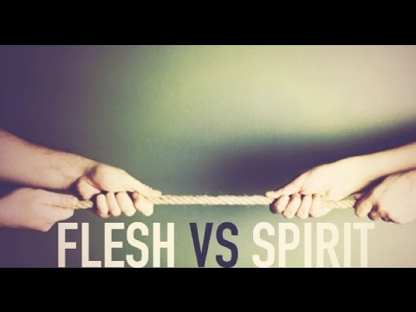
Being born again is only the beginning
Salvation of the Soul (Present - daily):
Phil 2:12-13 - Therefore, my beloved, as you have always obeyed, not as in my presence only, but now much more in my absence, work out your own salvation with fear and trembling; for it is God who works in you both to will and to do for His good pleasure.
Struggles between the flesh and the spirit:
Rom 8:5-13, Gal 5:17 For the flesh lusts against the Spirit, and the Spirit against the flesh; and these are contrary to one another, so that you do not do the things that you wish.

Slide 4
We need to die daily
1 Cor 15:31 - I affirm, by the boasting in you which I have in Christ Jesus our Lord, I die daily
Watchman Nee – “Secrets to Spiritual Power”
“The blood can wash away my sins, but it cannot wash away my ‘old man’. For this we are in need of the Cross, that the old man may be crucified. Though the blood deals with sins, it is the Cross that deals with the sinner.
Rom 6:6-8 - knowing this, that our old man was crucified with Him, that the body of sin might be done away with, that we should no longer be slaves of sin. For he who has died has been freed from sin. Now if we died with Christ, we believe that we shall also live with Him

Slide 5
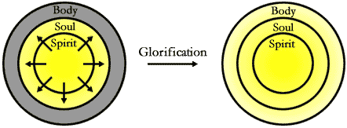
Complete salvation of the spirit, soul & body
Salvation of the Body (Future) 1 Cor 15:
1 John 3:2-3 - Beloved, now we are children of God; and it has not yet been revealed what we shall be, but we know that when He is revealed, we shall be like Him, for we shall see Him as He is. And everyone who has this hope in Him purifies himself, just as He is pure.
1 The 5:23 - Now may the God of peace Himself sanctify you completely; and may your whole spirit, soul, and body be preserved blameless at the coming of our Lord Jesus Christ.

Slide 6
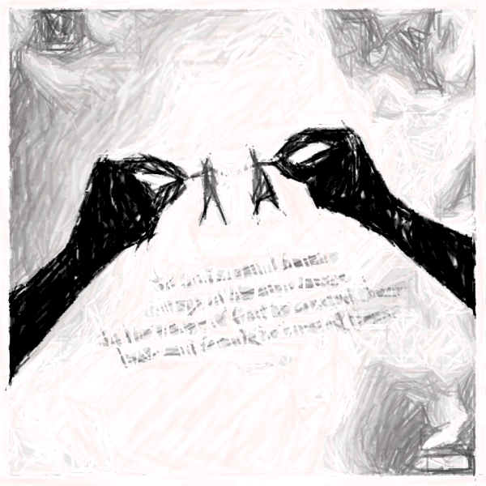
Gen 1:26-31 (Recap)
Created in the image and likeness of God
Created as a spirit being, with soul & body
Created to have a relationship with God*
Created to serve God with His provisions
Created to rule and reign with God
Rom 8:15 - For you did not receive the spirit of bondage again to fear, but you received the Spirit of adoption by whom we cry out, “Abba, Father.”

Slide 7
Psalm 8 – Rule and Reign with Christ
O Lord, our Lord, How excellent is Your name in all the earth,
Who have set Your glory above the heavens!
² Out of the mouth of babes and nursing infants, You have ordained strength, Because of Your enemies, That You may silence the enemy and the avenger.
³ When I consider Your heavens, the work of Your fingers,
The moon and the stars, which You have ordained,
⁴ What is man that You are mindful of him, And the son of man that You visit him? ⁵ For You have made him a little lower than the angels, And You have crowned him with glory and honor.
⁶ You have made him to have dominion over the works of Your hands; You have put all things under his feet, ⁷ All sheep and oxen - Even the beasts of the field, ⁸ The birds of the air, And the fish of the sea, That pass through the paths of the seas.
⁹ O Lord, our Lord, How excellent is Your name in all the earth!

Slide 8
Psalm 8 – Rule and Reign with Christ
O Lord, our Lord, How excellent is Your name in all the earth,
Who have set Your glory above the heavens!
² Out of the mouth of babes and nursing infants, You have ordained strength, Because of Your enemies, That You may silence the enemy and the avenger.
³ When I consider Your heavens, the work of Your fingers,
The moon and the stars, which You have ordained,
⁴ What is man that You are mindful of him, And the son of man that You visit him? ⁵ For You have made him a little lower than the angels, And You have crowned him with glory and honor.
⁶ You have made him to have dominion over the works of Your hands; You have put all things under his feet, ⁷ All sheep and oxen - Even the beasts of the field, ⁸ The birds of the air, And the fish of the sea, That pass through the paths of the seas.
⁹ O Lord, our Lord, How excellent is Your name in all the earth!

Slide 9
Psalm 8 – Rule and Reign with Christ
O Lord, our Lord, How excellent is Your name in all the earth,
Who have set Your glory above the heavens!
² Out of the mouth of babes and nursing infants, You have ordained strength, Because of Your enemies, That You may silence the enemy and the avenger.
³ When I consider Your heavens, the work of Your fingers,
The moon and the stars, which You have ordained,
⁴ What is man that You are mindful of him, And the son of man that You visit him? ⁵ For You have made him a little lower than the angels, And You have crowned him with glory and honor.
⁶ You have made him to have dominion over the works of Your hands; You have put all things under his feet, ⁷ All sheep and oxen - Even the beasts of the field, ⁸ The birds of the air, And the fish of the sea, That pass through the paths of the seas.
⁹ O Lord, our Lord, How excellent is Your name in all the earth!

Slide 10
Heb 2:8-9 - ⁸ You have put all things in subjection under his feet. For in that He put all in subjection under him, He left nothing that is not put under him. But now we do not yet see all things put under him. ⁹ But we see Jesus, who was made a little lower than the angels, for the suffering of death crowned with glory and honor, that He, by the grace of God, might taste death for everyone.
We must let the Cross work in us to make us willing to deliver ourselves daily to death for the Lord’s sake, abhorring the strength that belongs to our natural life and placing no confidence in ourselves or anything that proceeds from self. Only in this way will we see the life of God and His power flowing into other people’s spirits through our words.

Slide 11
2 Tim 2:11-13
¹¹ This is a faithful saying:
For if we died with Him,
We shall also live with Him.
¹² If we endure,
We shall also reign with Him.
If we deny Him,
He also will deny us.
¹³ If we are faithless,
He remains faithful;
He cannot deny Himself.

Slide 12
Conclusion
God created man to have dominion
(Gen 1:26)
Man was ruined by sin & death
Jesus came from heaven to earth to become as man to die so we might have life (John 12:24-26)
Before we can rule and reign with Christ: - We need to die to self, How?
- Depend on the Holy Spirit. How?
- Talk to Him as a person.

